Slide 1
Shall Eniac sign a deal with Magist?
Presented by: Fatima, Sina & Anish

Slide 2
Magist: may not be an effective platform for Eniac to enter the Brazilian market
Based on 3 business questions
How well does Magist manage to sell tech. products?
How efficient is Magist with customer deliveries?
What is the market condition for tech. products in Brazil?

Slide 3
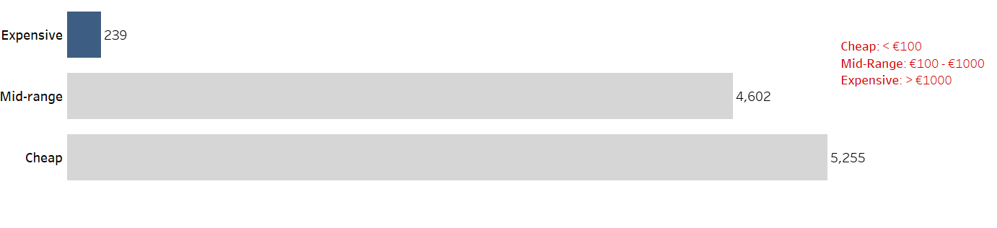
Magist sold only 2.37% expensive products

Slide 4
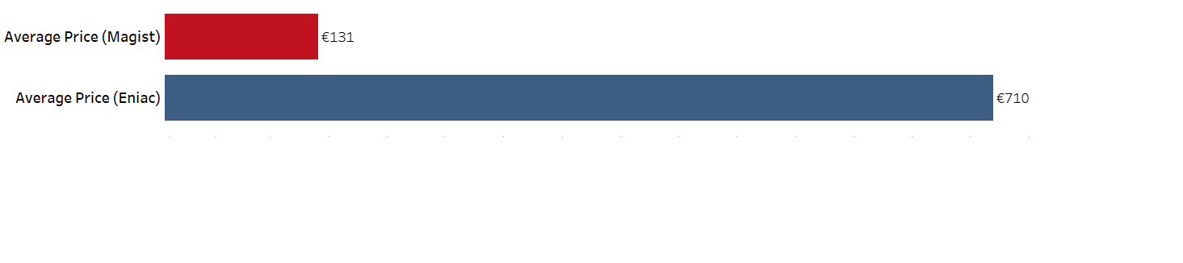
Average price of products sold by Magist was €131

Slide 5
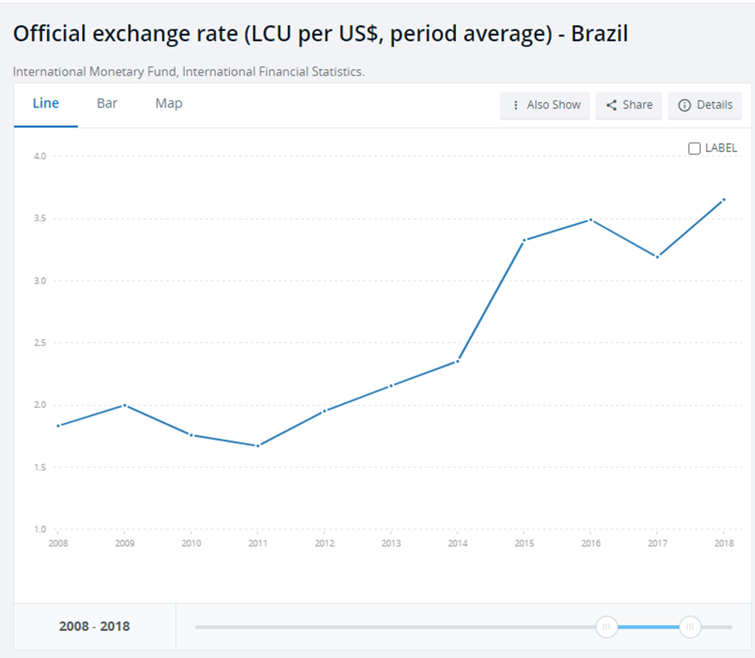
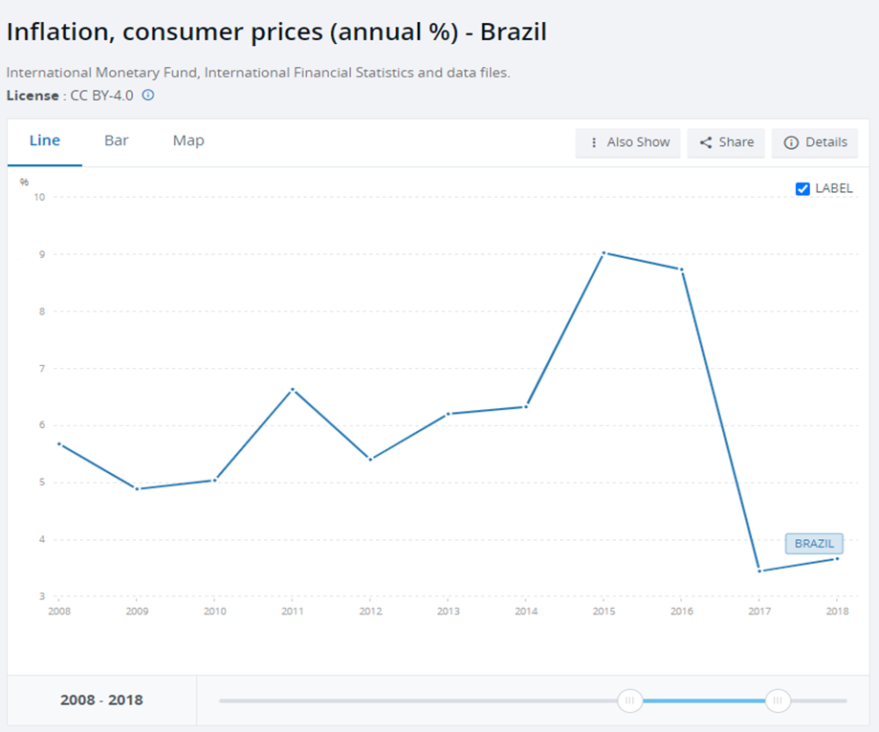

High Inflation
www.worldbank.org

Slide 6
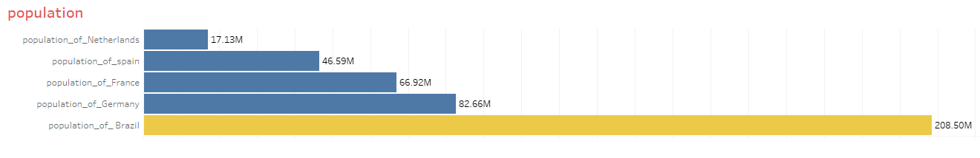
Consumer Market Size
Brazil = Germany+France+Netherlands+Spain
www.worldbank.org

Slide 7
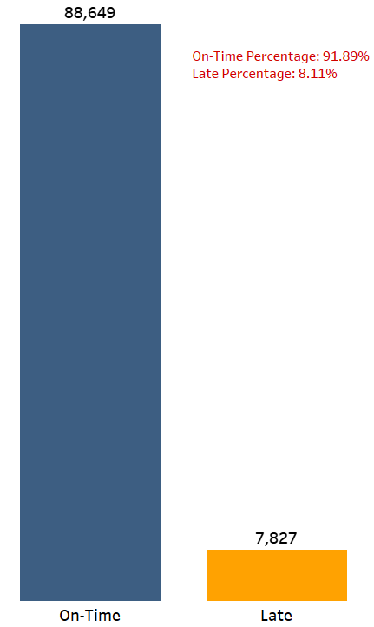
Effective customer deliveries
Average delivery time for Magist = 12.5 days
Average delivery time for others = 21 days

Slide 8
Summary
Positive
Delivery time is comparably good
Consumer Market Size
Negative
Sales of expensive products are only 2.37%
Customer base of Magist is more interested in cheaper products
High inflation in Brazil

